Slide 1


Information Science and Engineering
Project Seminar
Web Application Development
Under the Guidance of
Asst. Prof. VADIRAJA A
Dept. of ISE
SWAROOP NADIGER [ 1JT15IS044 ]

Slide 2


Company Profile
Rackminds Technologies Solutions is a global provider of Consulting, Information Technology IT and Business Process Outsourcing services BPO services.
Rackminds founded in 2006, specializes in software outsourcing and solution Provider Company.
Rackminds is one of the fastest growing IT Services and Solution Company specializing in implementation of SAP Solutions, Oracle, and Web Application to clients.

Slide 3
Introduction
A Web application development is the creation of application programs that reside on remote servers and are delivered to the user’s device over the Internet.
The web app does not need to be downloaded and is instead accessed through a network. An end user can access a web application through a Web Browser.
The Front-end development for web applications is accomplished through client-side programming.
The Server-side programming powers the client-side programming and is used to create the scripts that web applications use.

Slide 4
Objective
To create a portal to store the details of the Benefits claimed by Workers.
Automatic report generation of benefitted workers from each category of benefits of each month.

Slide 5
Proposed System
Study the shortcomings of the already existing Website, identifying bugs and develop a web application for Beneficiaries details entry.
To create an Automated report generation process to fetch the beneficiaries details for a given month and location.

Slide 6
Tasks Performed
Requirements Gathering and Analysis
Feasibility
Design of application
Database creation
GUI development

Slide 7
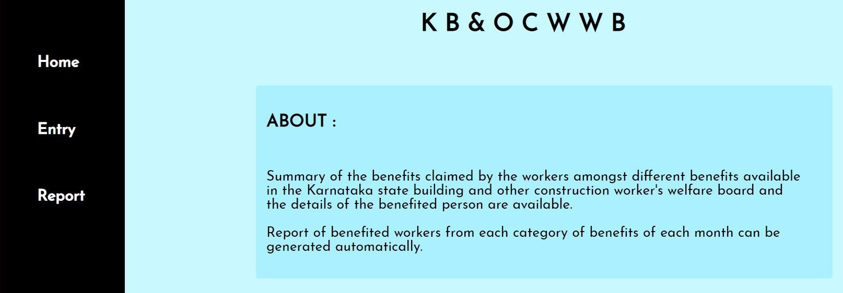
Snapshots
About Page of the Website

Slide 8
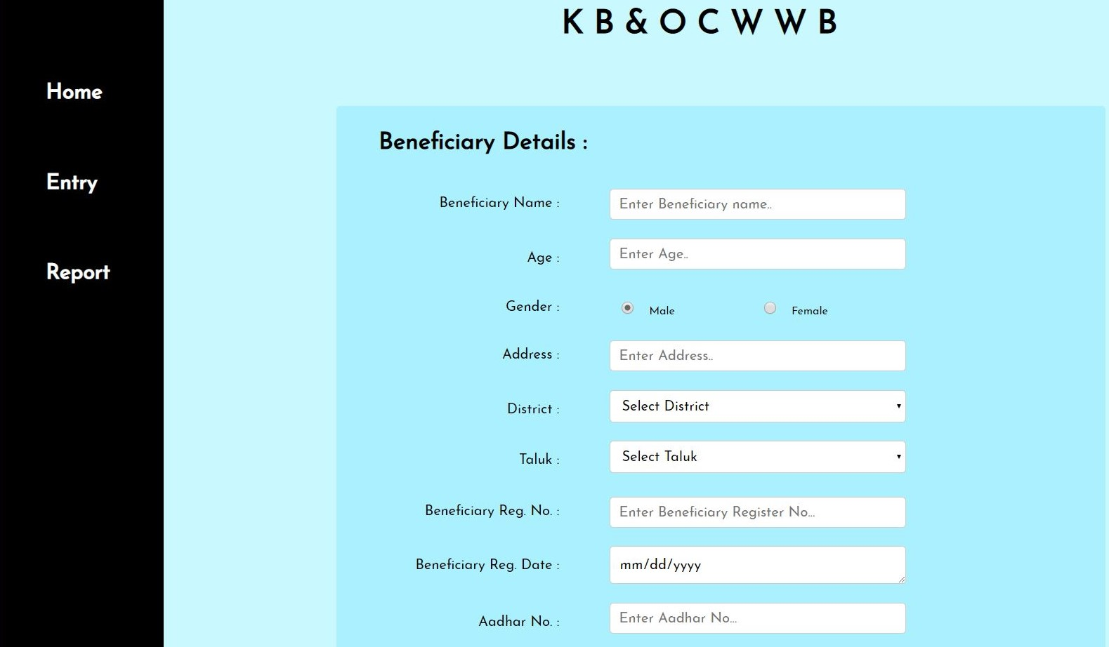
Data Entry ( Beneficiary Details )

Slide 9
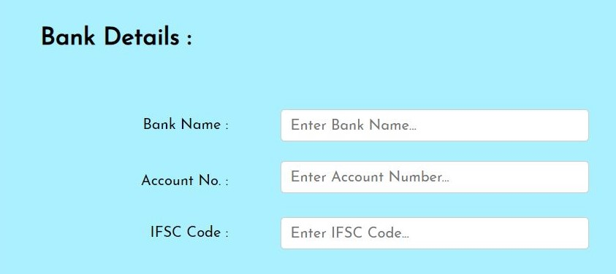
Data Entry ( Bank Details )

Slide 10
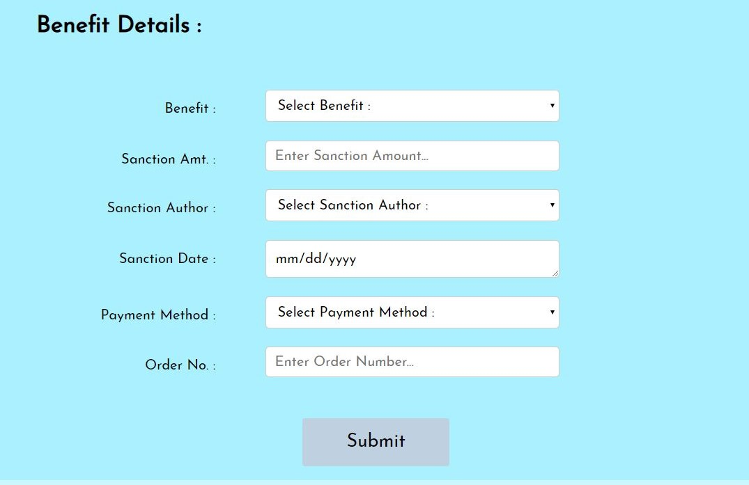
Data Entry ( Benefit Details )

Slide 11
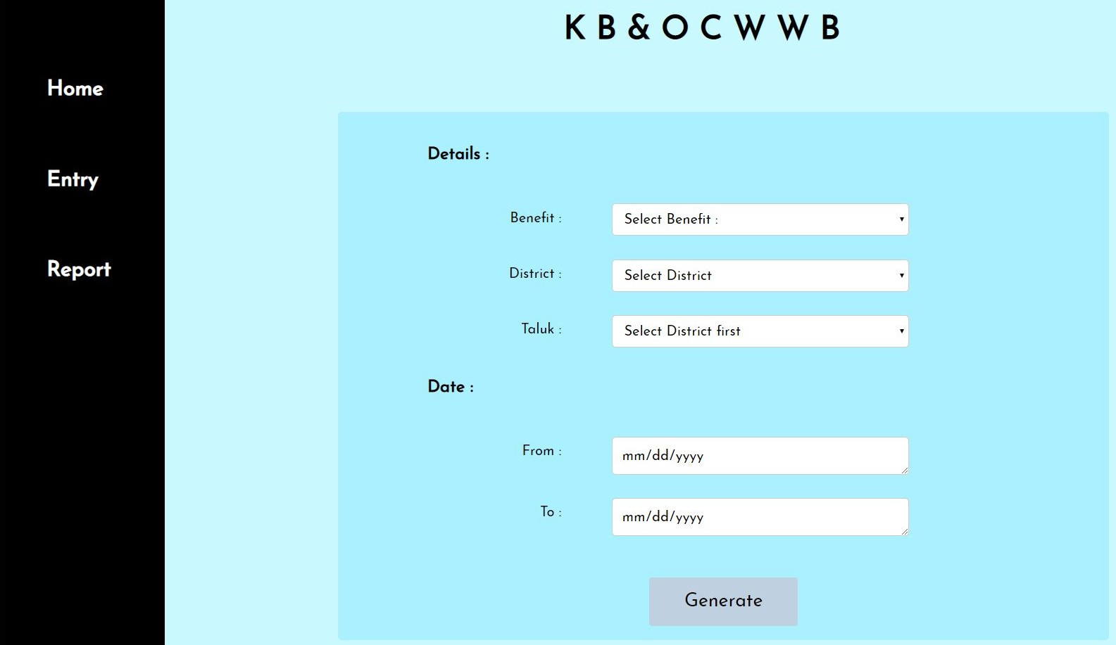
Report Generation Page of Website

Slide 12
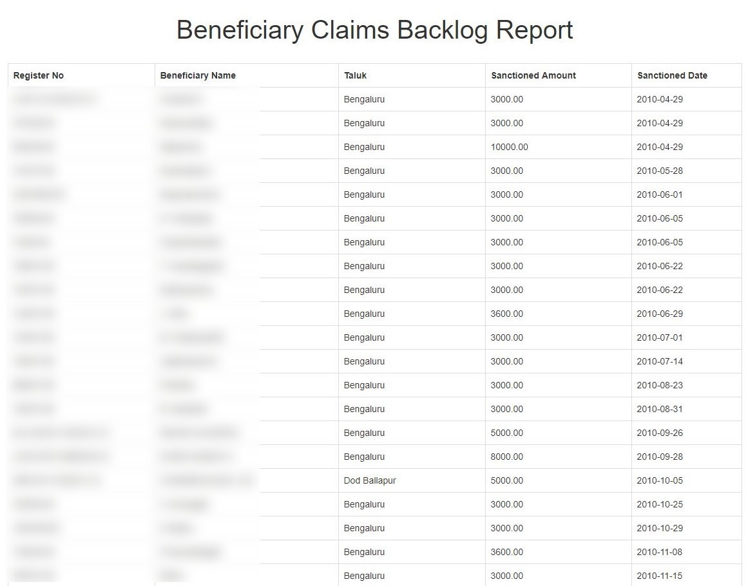
Example of Report Generation

Slide 13

THANK YOU

